Slide 1

Examination Portal
project REPORT On
Submitted in partial fulfillment of the requirement for the award of
Degree Of
BACHELOR OF COMPUTER APPLICATIONS
Submitted to
CIMAGE PROFESSIONAL COLLEGE, PATNA
SESSION: 2020-23

Slide 2
Submitted By:
NAME | ID | ROLL | REGISTRATION NO
Uttam Kumar | 11153 | 06 | 20303310008
UNDER THE GUIDANCE OF
Guide: Prof. Raju Upadhyay | H.O.D Er. Amit Kumar Shukla | In Charge Er. Neeraj Kumar Singh

Slide 3

What is Examination Portal?
An examination portal is a digital platform that facilitates the online administration of tests.
It replaces traditional paper-based tests with an online method that is both efficient and safe.
Administrators may utilize the site to design and schedule examinations, manage user accounts, and view real-time exam results.
Students may take examinations, submit answers, get immediate feedback, and examine their scores.

Slide 4
EXISTING SYSTEM
Existing system is a manual one in which users are maintaining books to store the information like Student Details, Instructor Details, Schedule Details and feedbacks about students who attempted exam as per schedule. It is very difficult to maintain historical data.
DISADVANTAGES
A lot of copies of question papers have to be made
A lot of correction work hence delay in giving the results
A lot of tabulation work for each subject results

Slide 5
PROPOSED SYSTEM
This application is used to conduct online examination.
The students can sit at individual terminals and login to write the exam in the given duration.
The questions have to be given to the students.
This application will perform correction, display the result immediately and also store it in database.
This application provides the administrator with a facility to add new exams.
This application provides the instructor add questions to the exam, modify questions in the exam in a particular exam.
This application takes care of authentication of the administrator, Instructor as well as the student.

Slide 6
Objectives of an Examination Portal:
Streamline the Assessment Process
Provide Flexibility and Accessibility:
Examination Portals aim to simplify the assessment process by digitally storing and automating operations, from test creation to result generation.
Exam portals provide students with flexibility and accessibility by allowing them to take tests remotely.
Enable Automated Grading and Result Processing:
Simplify Exam Management:
An Examination Portal enables quick and accurate grading of exams, reducing manual effort and providing timely feedback.
The portal's features simplify exam management, allowing teachers and administrators to focus on the educational aspects.

Slide 7
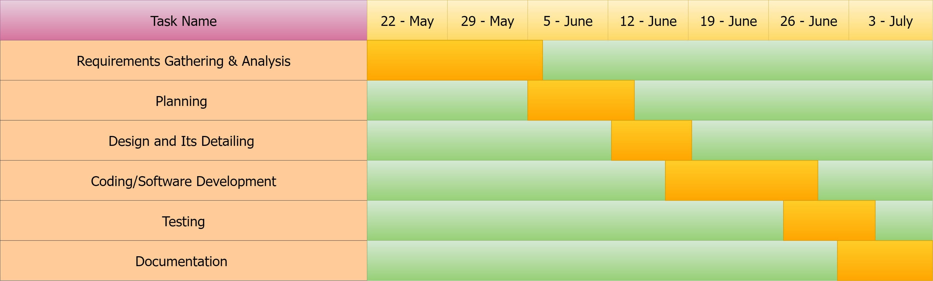
Gantt Chart

Slide 8

System Requirements
Hardware Requirements:-
Memory (RAM): 2 GB(minimum) of RAM required.
Hard Disk Space: 10 GB.
Processor: Intel Pentium 4 Dual Core GHz or higher.
Microsoft Compatible 101 or more Key Board
Software Requirements:-
Operating System : Windows
Front-End: HTML,CSS,JAVASCRIPT
Back-End: PHP & MySQL
Web Server: Apache SERVER.
Tool: XAMPP

Slide 9
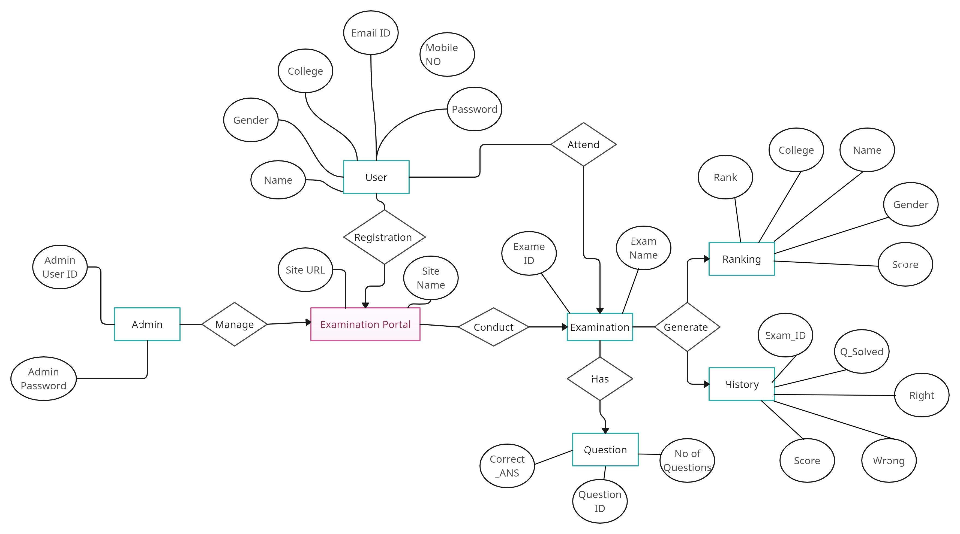
E-R Diagram

Slide 10
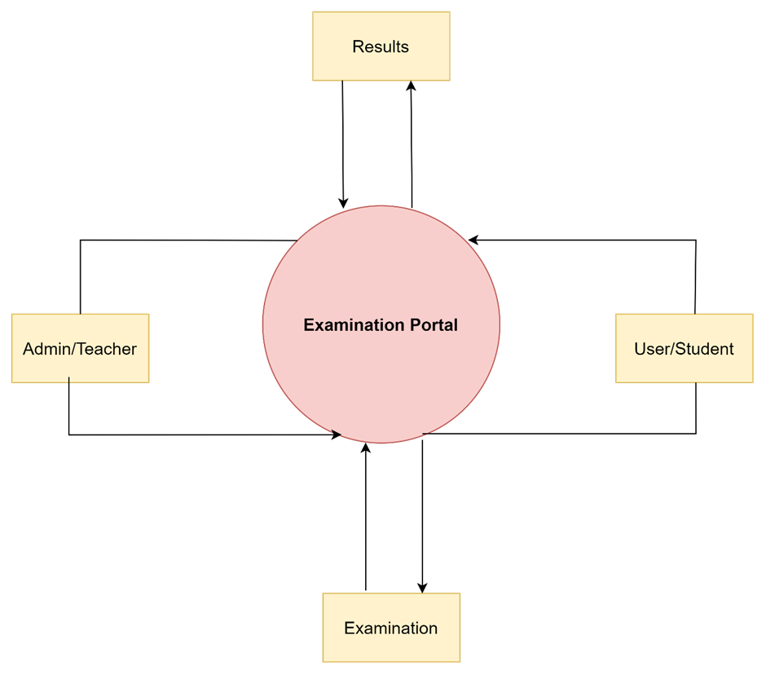
DFD
DFD is an abbreviation for Data Flow Diagram.
It is a graphical depiction of the data flow within a system or process.
A Data Flow Diagram consists of various components:
Processes: Processes represent the functions or activities that manipulate the data. They are depicted as circles or rectangles in a DFD.
Data Stores: Data Stores represent where data is stored within the system. They can be databases, files, or even physical locations where data is stored temporarily or permanently.
Data Flows: Data Flows represent the movement of data from one entity to another. They are depicted as arrows and show the direction in which data is passed between processes, data stores, and external entities.
External Entities: External Entities are sources or destinations of data that interact with the system but are external to it. They can be users, other systems, or external organizations.
0 – Level DFD

Slide 11
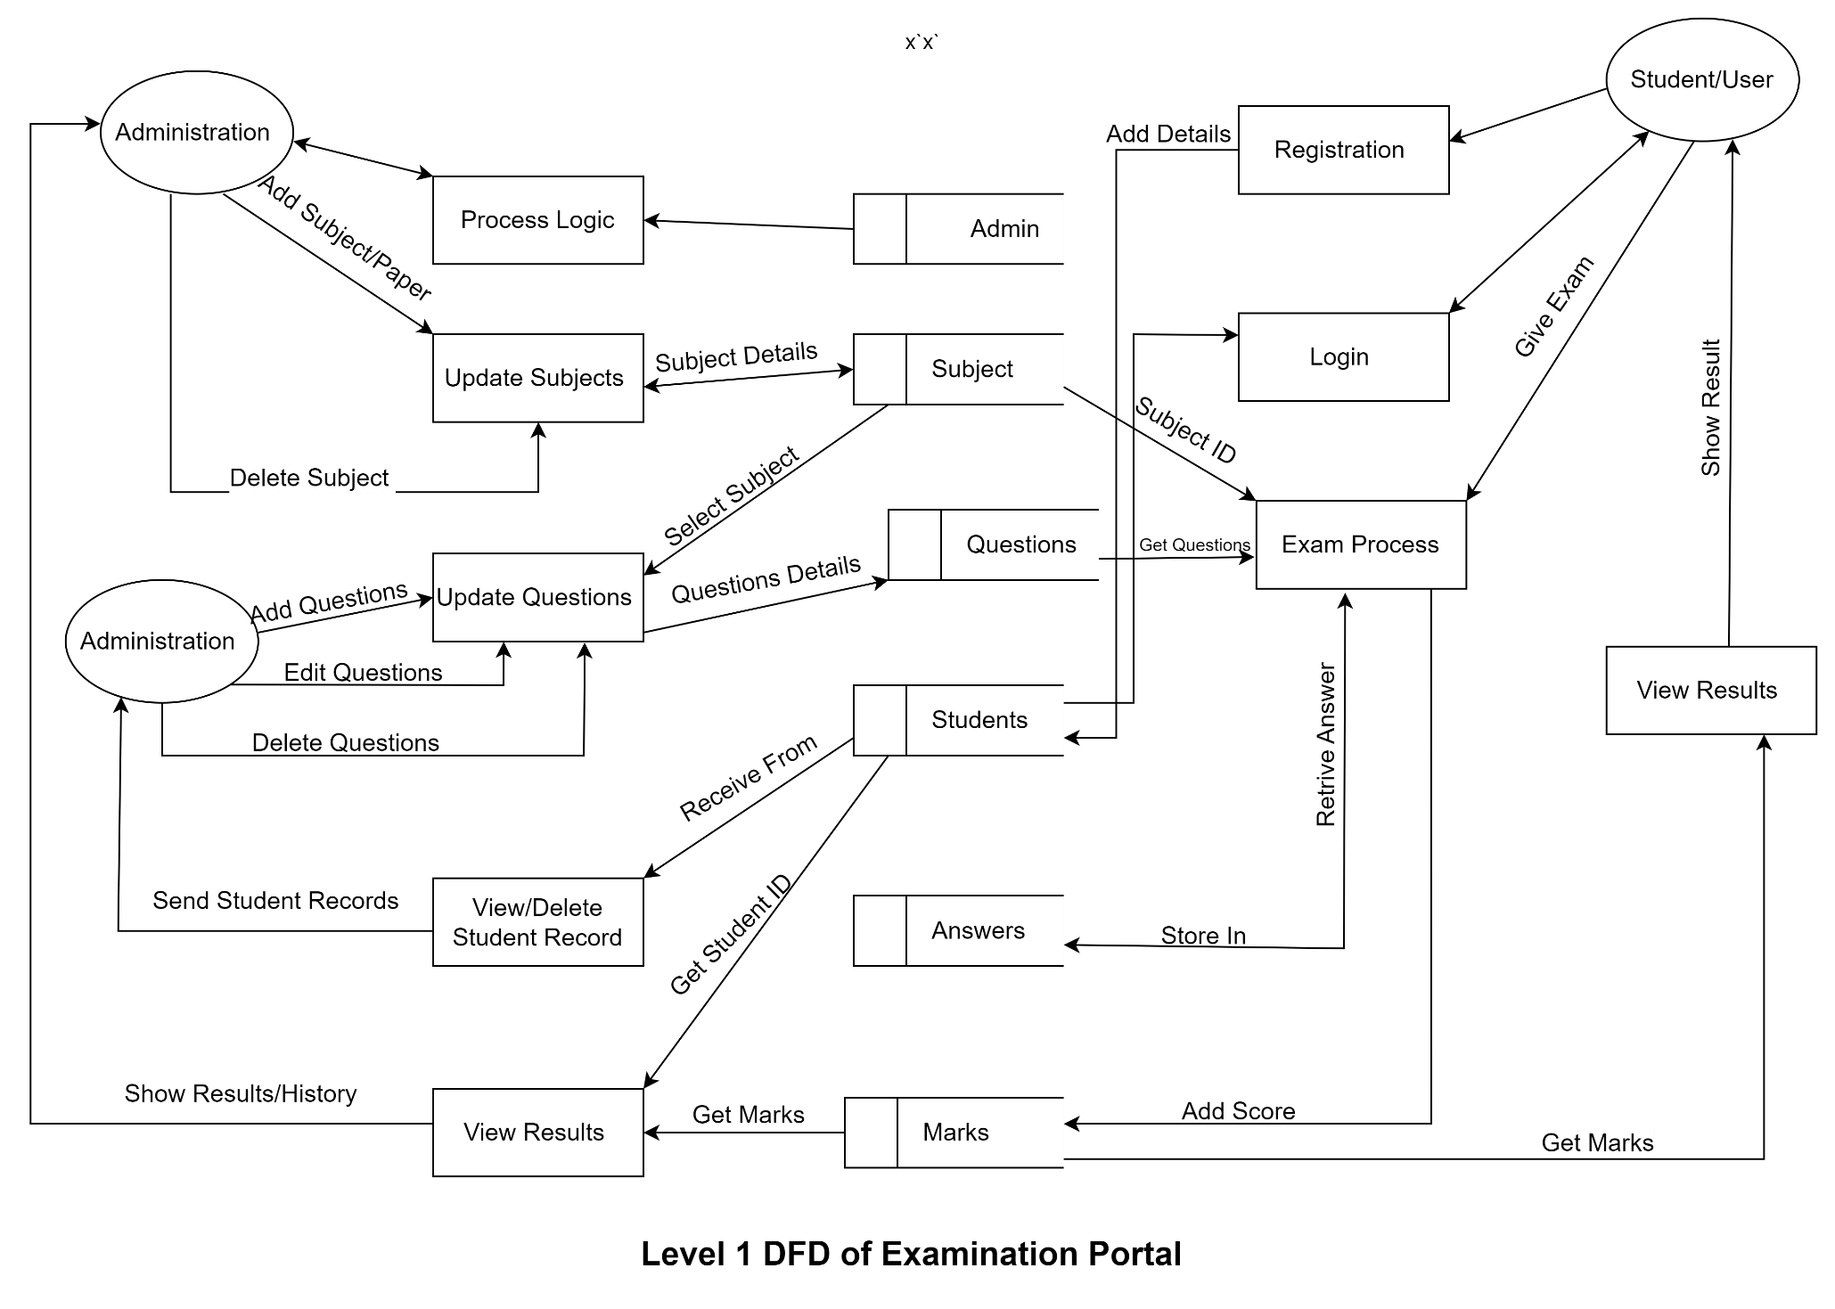
LEVEL 1 – DFD

Slide 12

Database Tables

Slide 13
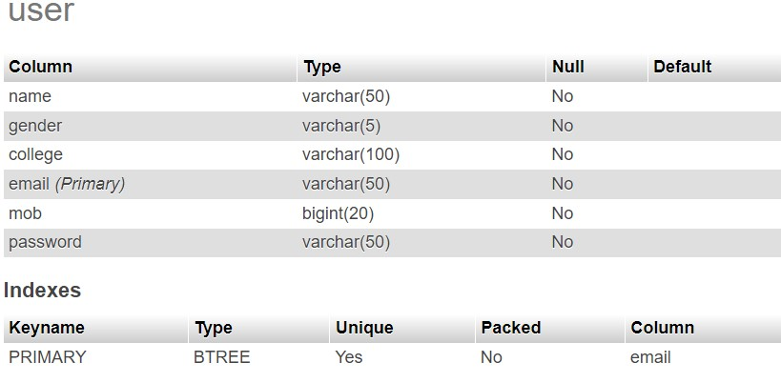
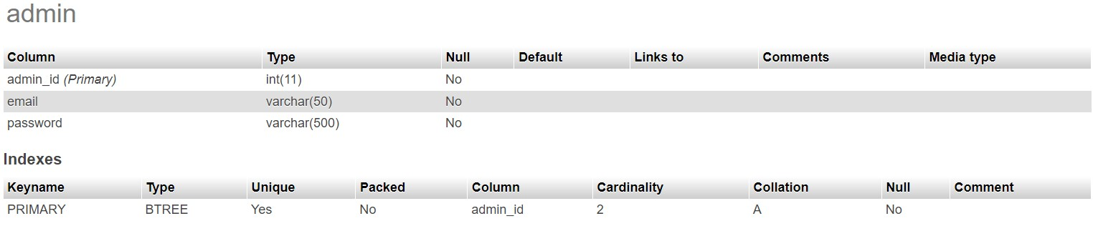

Slide 14
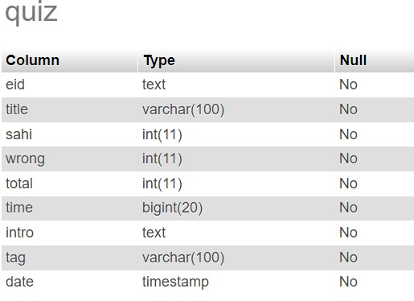
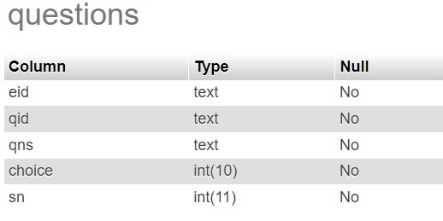

Slide 15
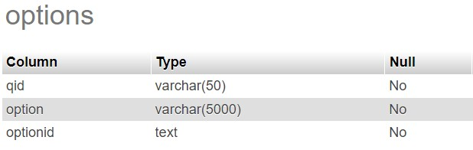
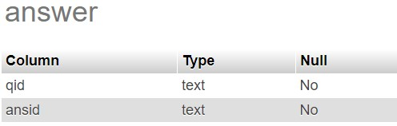
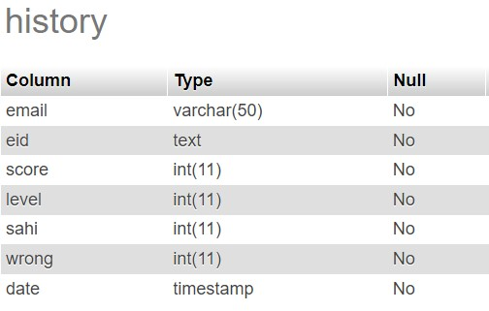

Slide 16
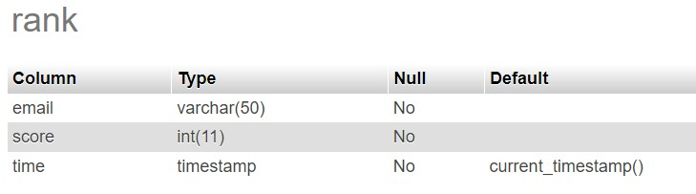
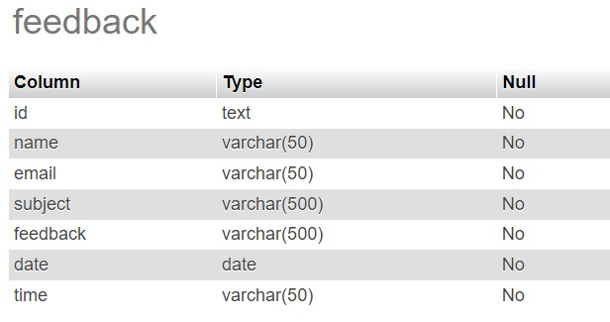

Slide 17
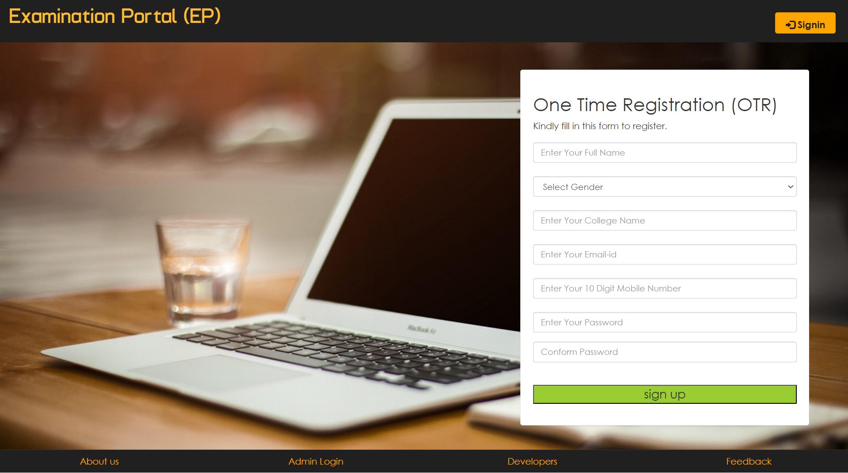
THE FRONT PAGE OF PROJECT

Slide 18
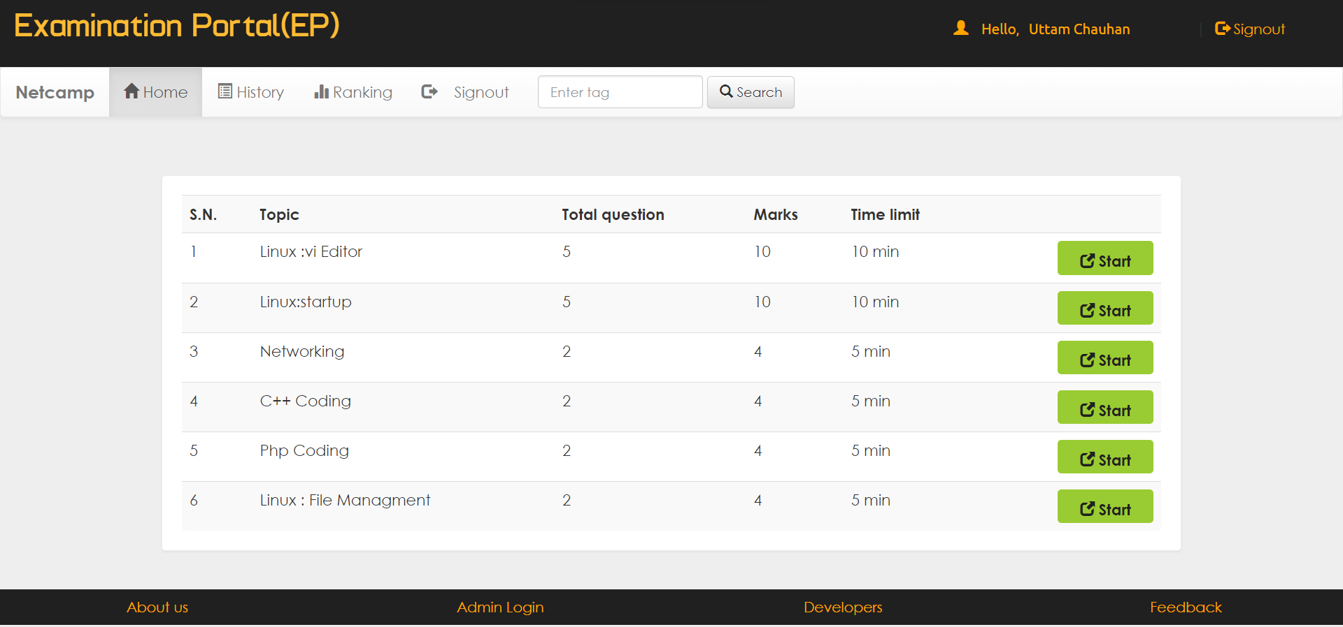
THE STUDENT DASHBOARD

Slide 19
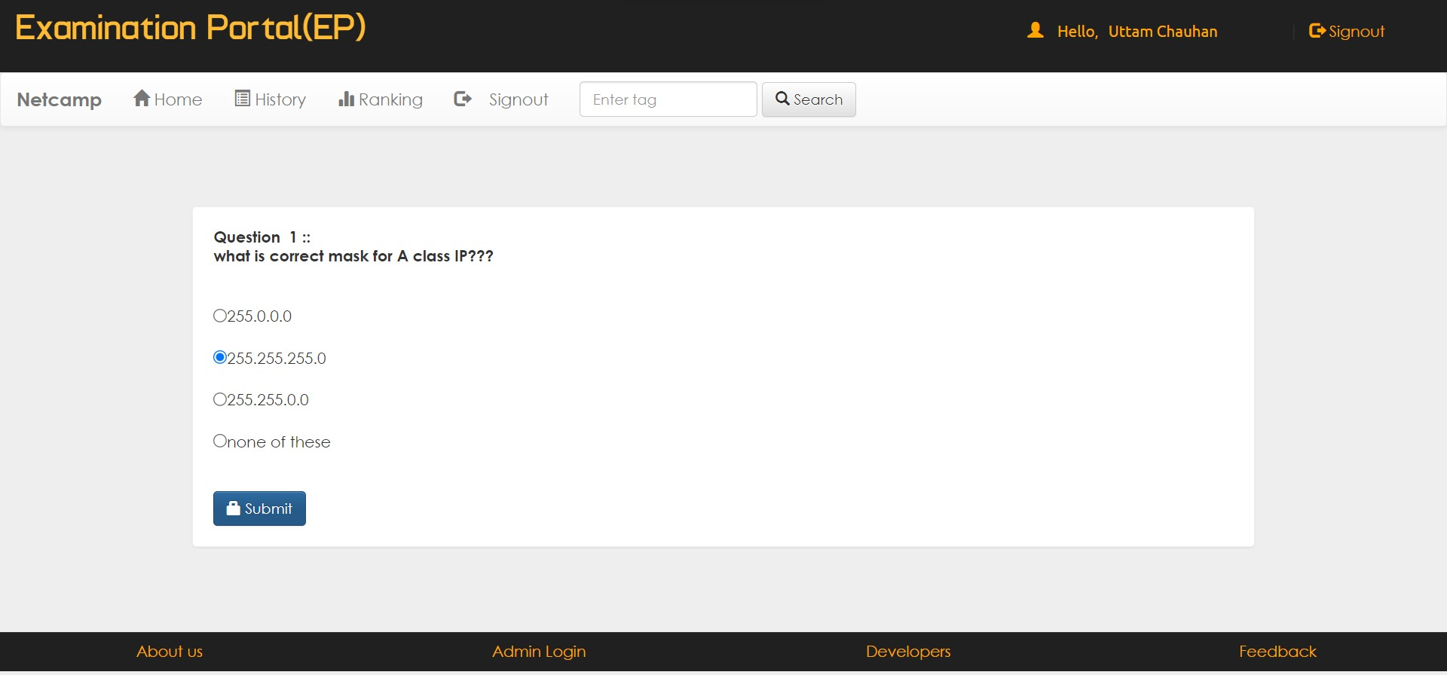
STUDENT EXAMINATION PAGE

Slide 20
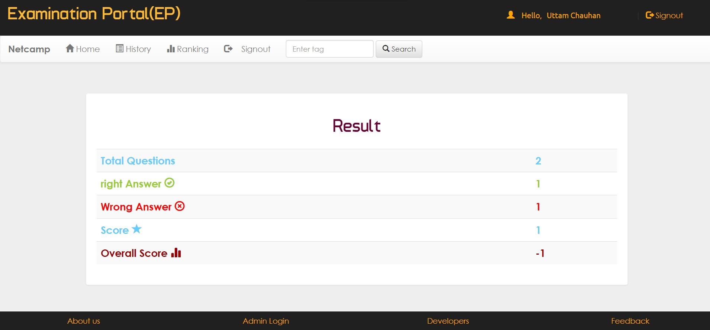
STUDENT EXAM RESULT PAGE

Slide 21
STUDENT EXAM RESULT

Slide 22
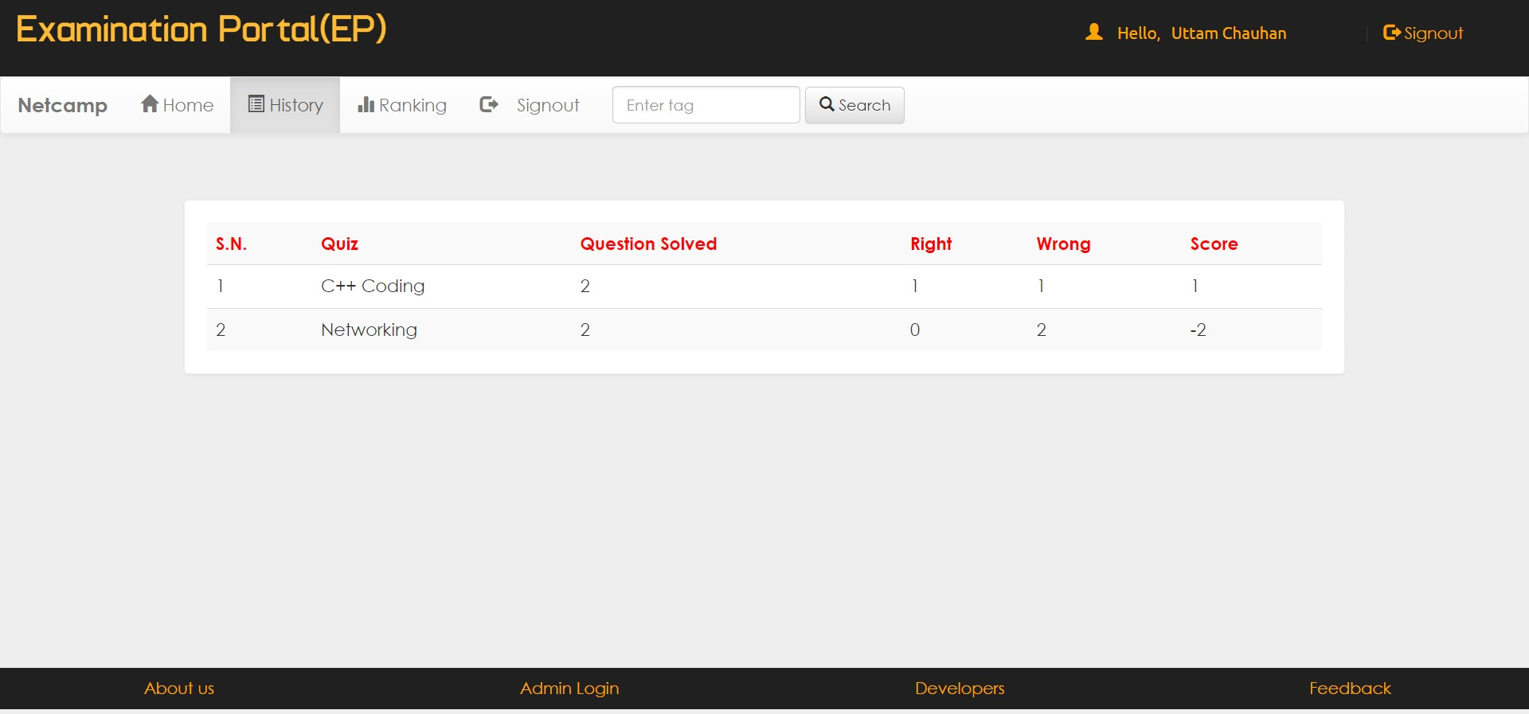
STUDENT RESULT HISTORY

Slide 23
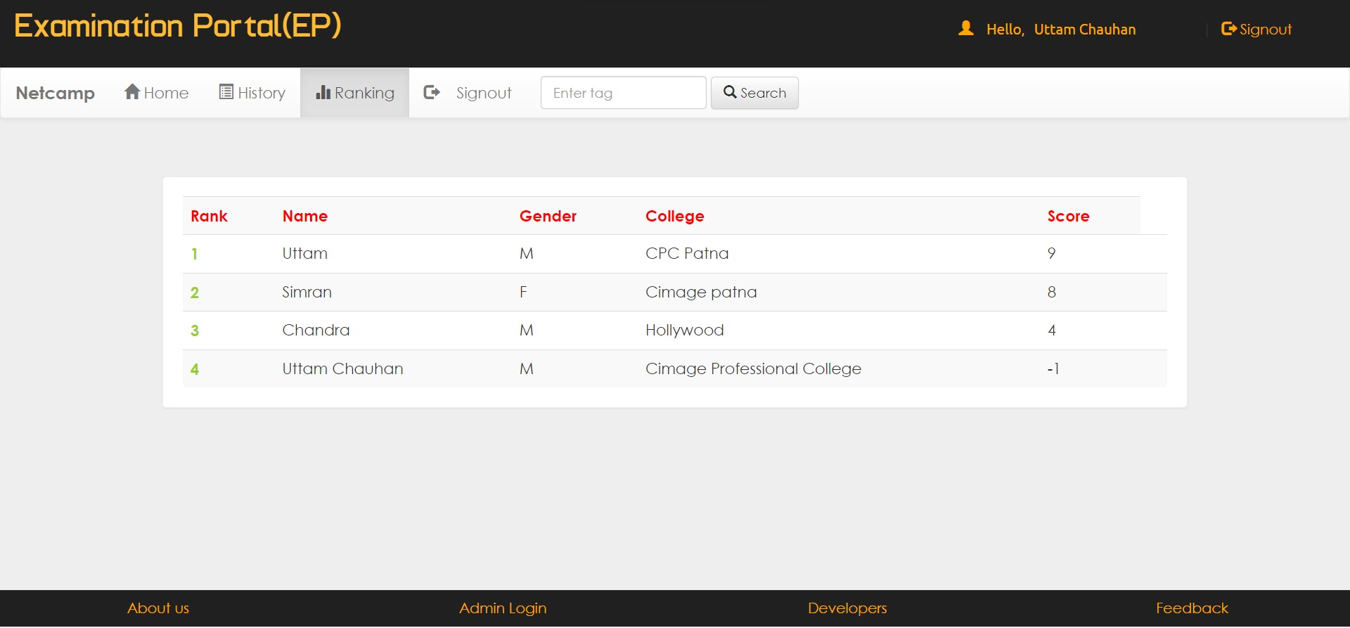
STUDENT RANKING PAGE

Slide 24
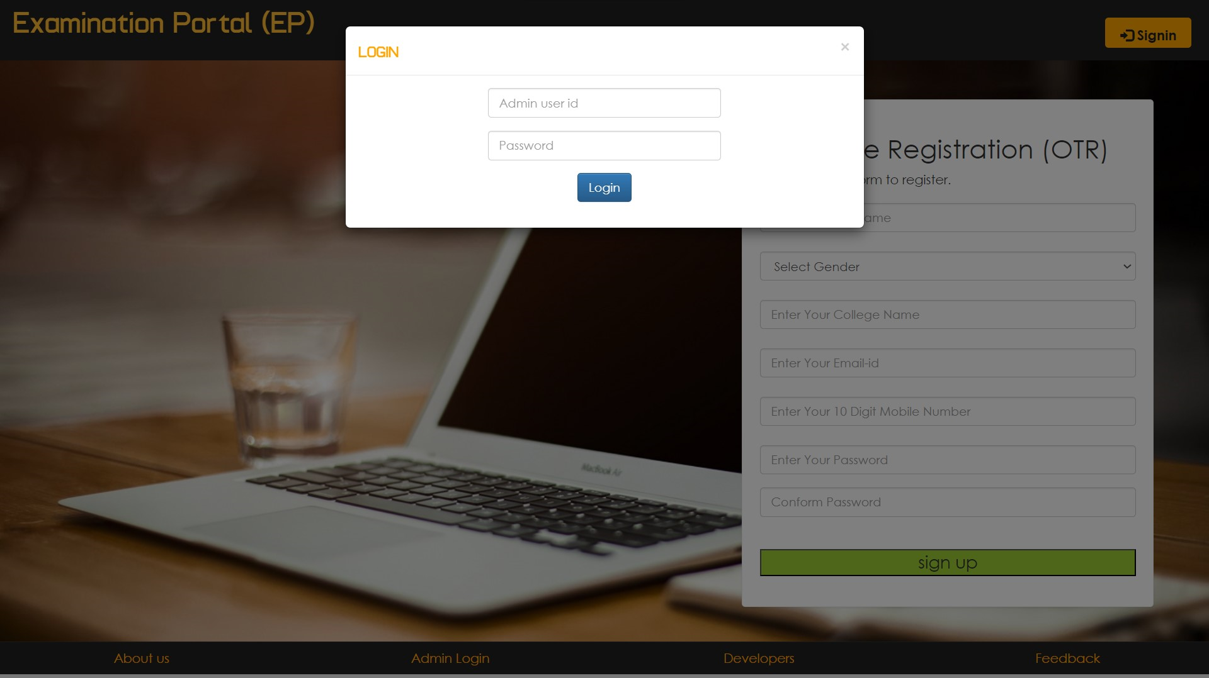
ADMIN LOG IN

Slide 25
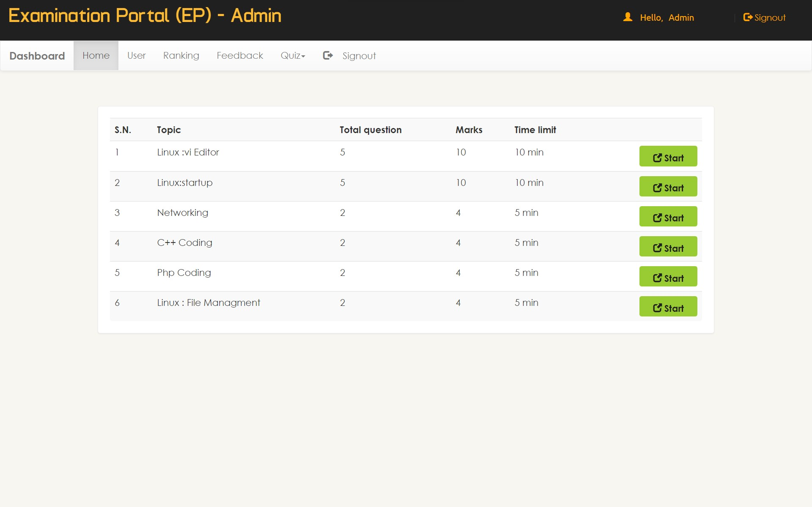
ADMIN DASHBORD PAGE

Slide 26
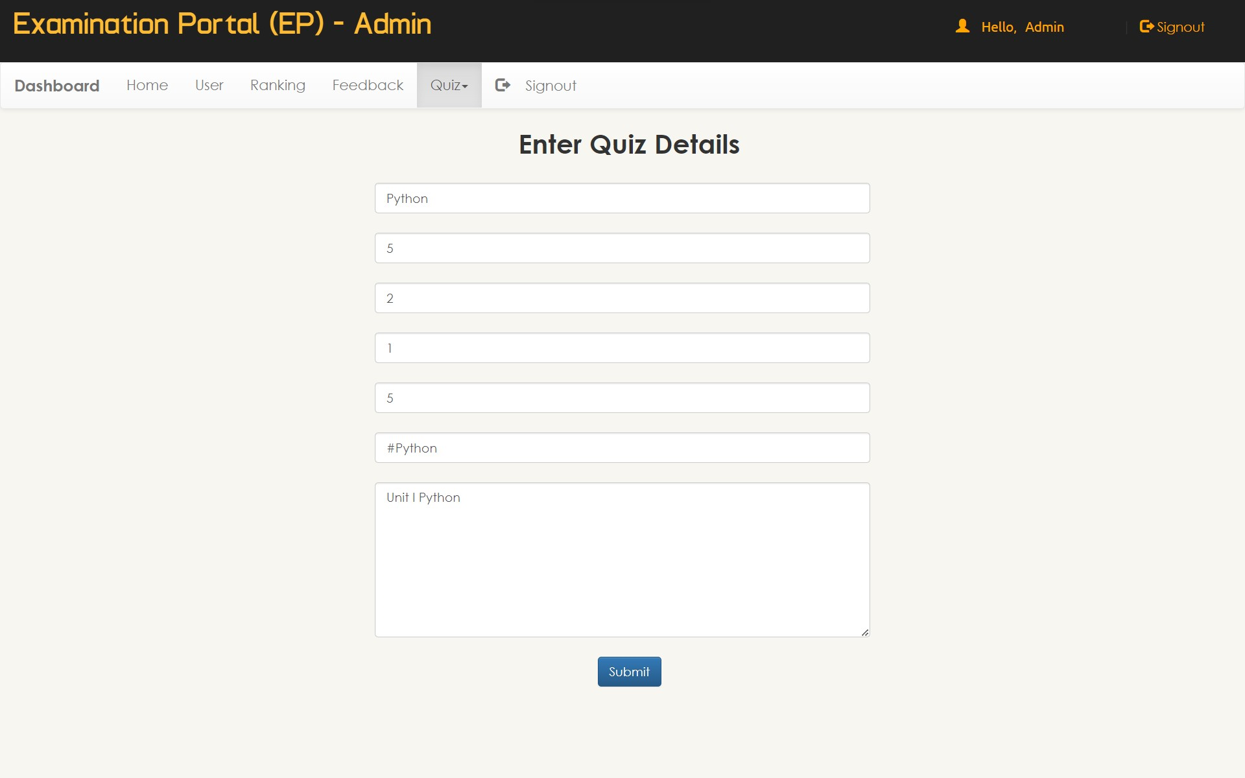
ADMIN ADD SUBJECT PAPER

Slide 27
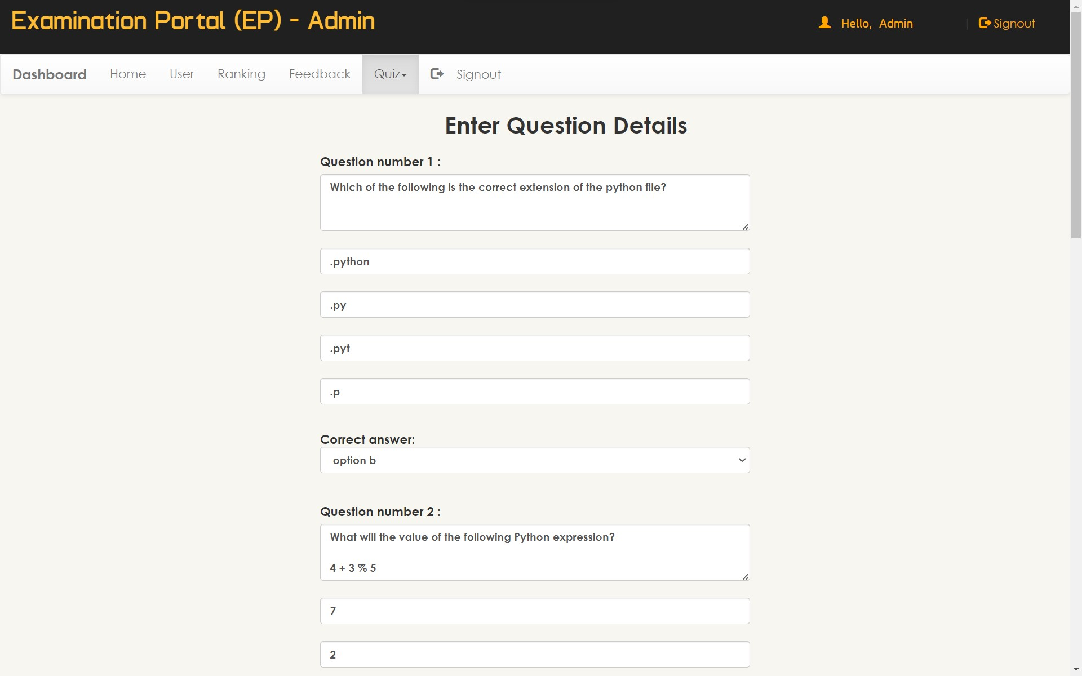
ADMIN ADD QUESTIONS & ANSWER

Slide 28
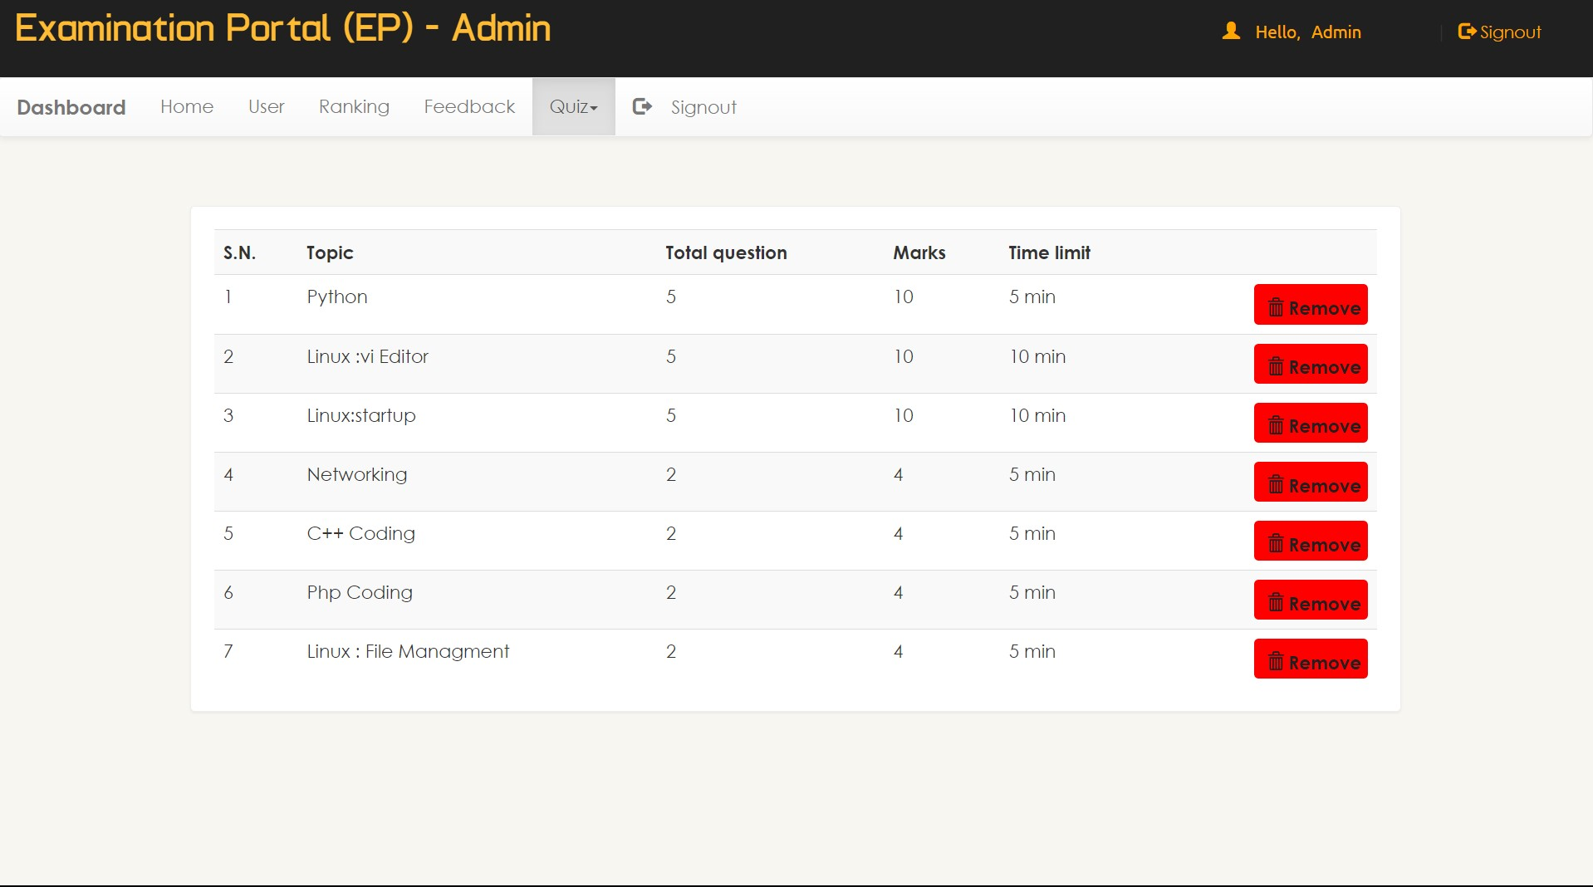
ADMIN REMOVE SUBJECT PAPER

Slide 29

Summary
An examination portal is a web-based application that facilitates the management and administration of exams and assessments. It provides a platform for conducting online exams, managing student information, grading, and generating reports. It should be designed to be accessible to users with disabilities and compatible with various devices and screen sizes.

Slide 30

Thank you

